Slide 1
Empowering Network Defense: Threat Intelligence Insights with Snort3 NIDS
-KUNAL

Slide 2
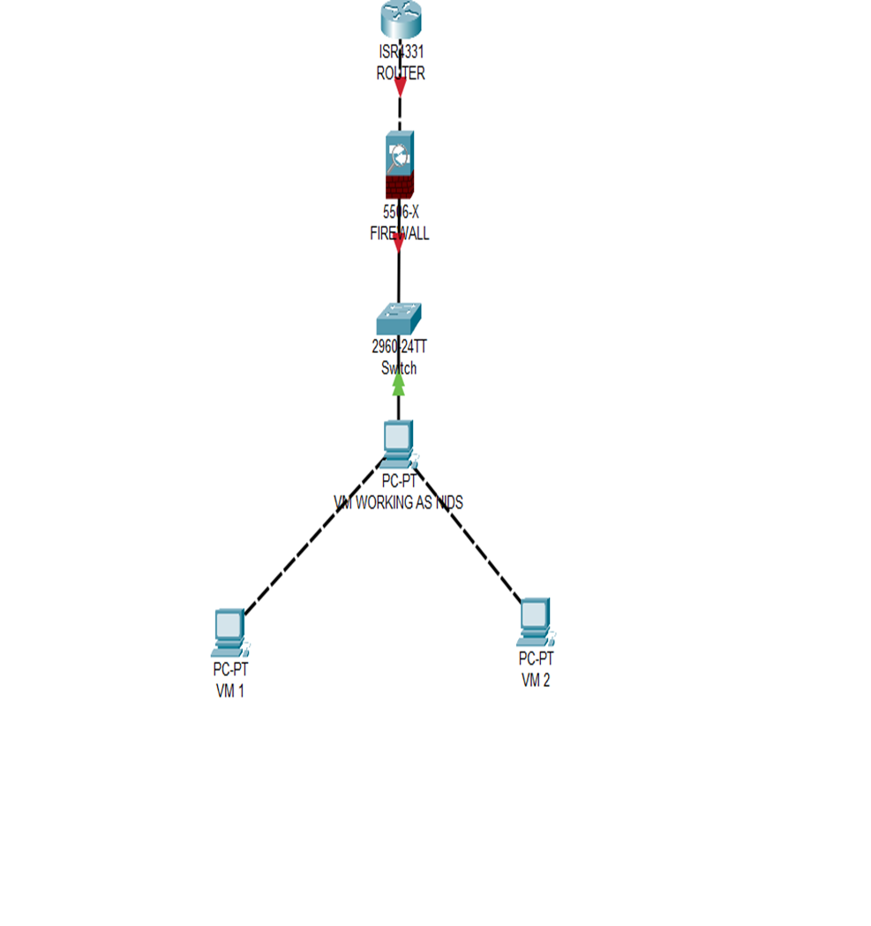
Lab Setup and Configuration:
•Established network environment with Snort VM, Kali Linux VM, and Windows VM.
•Utilized Oracle VM for VM configuration with allocated CPU, memory, and disk space.
•Implemented LAN topology for high-speed data transfer and ease of management

Slide 3

Integration with Snort
Installed and configured Snort as the core component for the IDS.
Leveraged Snort's robustness and flexibility in threat detection.

Slide 4
Log Analysis and Excel Output:
Capture network packets using Snort's packet sniffer.
Analyzed logs with the threat intelligence tool.
Stored valuable information (severity, timestamp, IP, protocol, etc.) in an Excel file.

Slide 5
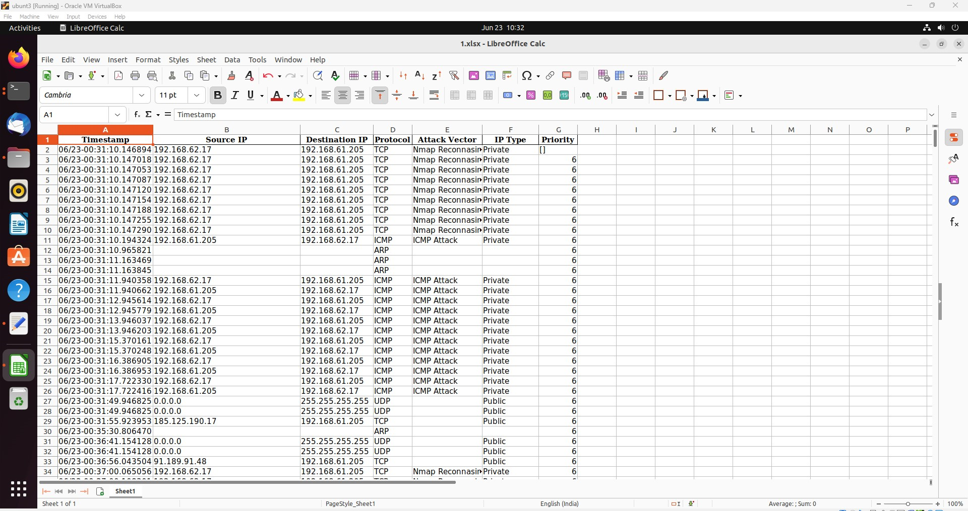

Slide 6
PDF Report Generation:
Generated detailed PDF reports summarizing log analysis results.
Included log details and visually informative pie charts for intuitive data representation.

Slide 7
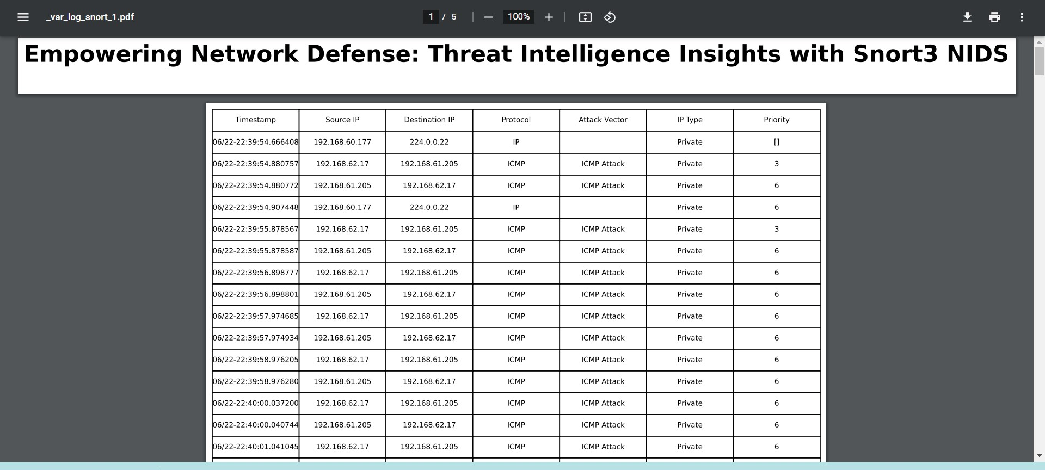

Slide 8
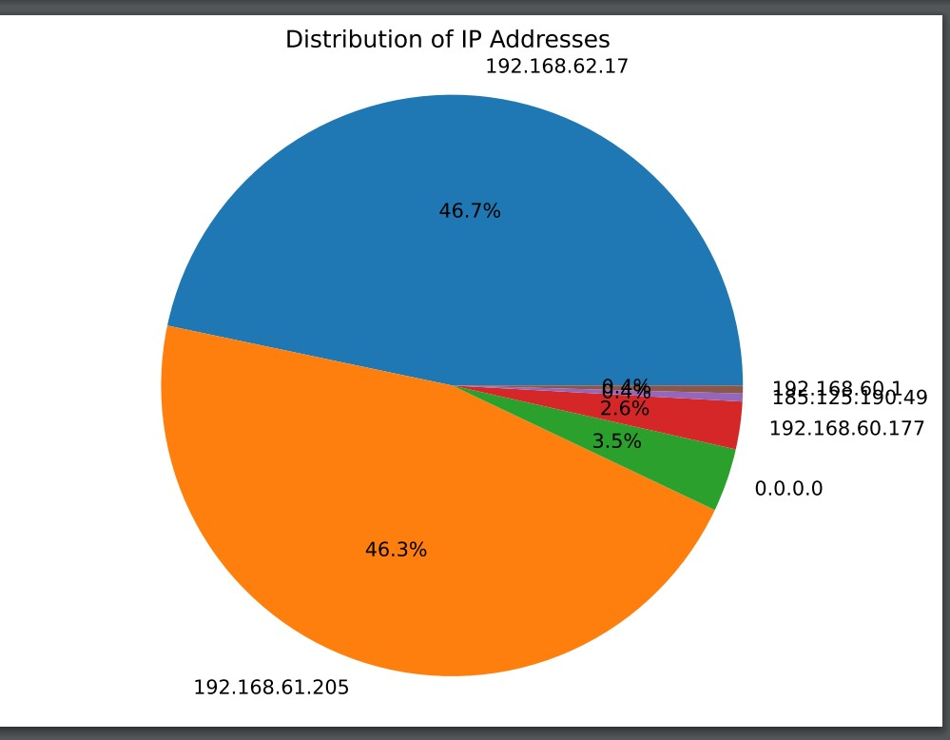

Slide 9
Real-time Alerts and Email Notifications:
Enabled real-time alerts and notifications through Snort's bash script rule.
Analyzed captured logs for potential threats.
Automatically responded based on severity levels and sent email notifications with PDF reports.

Slide 10
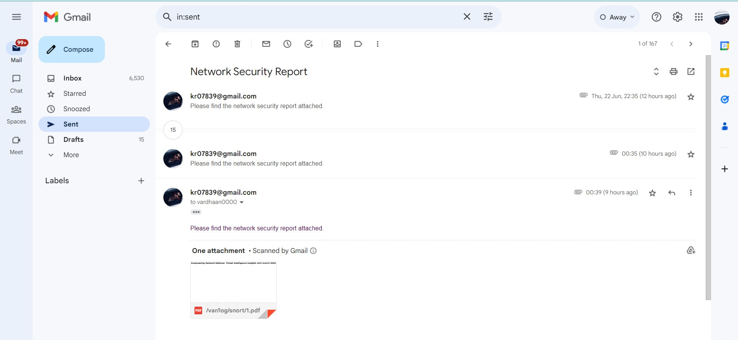

Slide 11
Scalability and Maintenance:
Designed the IDS system to accommodate additional devices and network traffic.
Implemented a maintenance plan to keep Snort up to date with the latest threats and vulnerabilities.

